Slide 1
FLOWCHART
Qonitatul Hasanah, S.S.T., M.Tr.T.

Slide 2
Flowchart
A flowchart is simply a graphical representation of steps. It shows steps in sequential order and is widely used in presenting the flow of algorithms, workflow or processes. Typically, a flowchart shows the steps as boxes of various kinds, and their order by connecting them with arrows.
Notes:
Diagram alir hanyalah representasi grafis dari langkah-langkah. Ini menunjukkan langkah-langkah berurutan dan banyak digunakan dalam menyajikan aliran algoritma, alur kerja atau proses. Biasanya, diagram alur memperlihatkan langkah-langkah sebagai kotak dari berbagai jenis, dan urutannya dengan menghubungkannya dengan panah.

Slide 3
What is a Flowchart?
A flowchart is a graphical representations of steps. It was originated from computer science as a tool for representing algorithms and programming logic but had extended to use in all other kinds of processes. Nowadays, flowcharts play an extremely important role in displaying information and assisting reasoning. They help us visualize complex processes, or make explicit the structure of problems and tasks. A flowchart can also be used to define a process or project to be implemented.
Notes:
Flowchart adalah representasi grafis dari langkah-langkah. Itu berasal dari ilmu komputer sebagai alat untuk mewakili algoritma dan logika pemrograman tetapi telah diperluas untuk digunakan dalam semua jenis proses lainnya. Saat ini, diagram alur memainkan peran yang sangat penting dalam menampilkan informasi dan membantu penalaran. Mereka membantu kita memvisualisasikan proses yang kompleks, atau membuat eksplisit struktur masalah dan tugas. Flowchart juga dapat digunakan untuk mendefinisikan suatu proses atau proyek yang akan dilaksanakan.

Slide 4
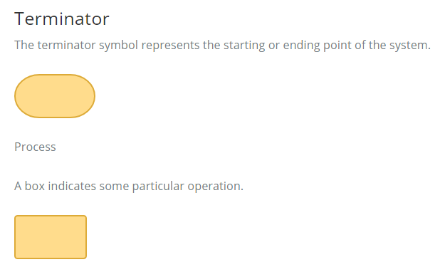
Flowchart Symbols Different meanings. The meanings of some of the more common shapes are as follows:flowchart shapes have different conventional

Slide 5
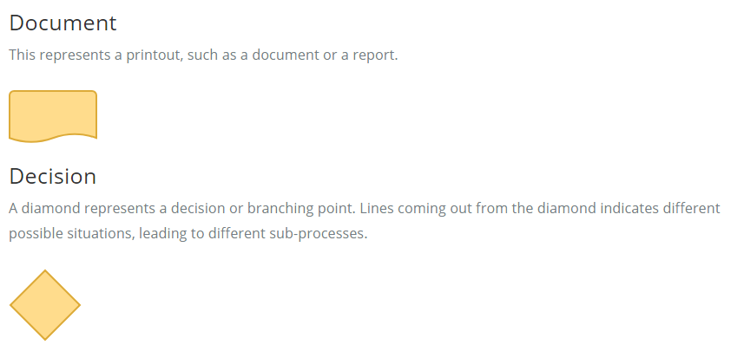

Slide 6
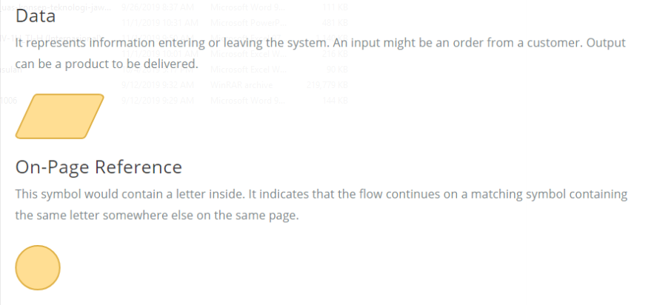

Slide 7
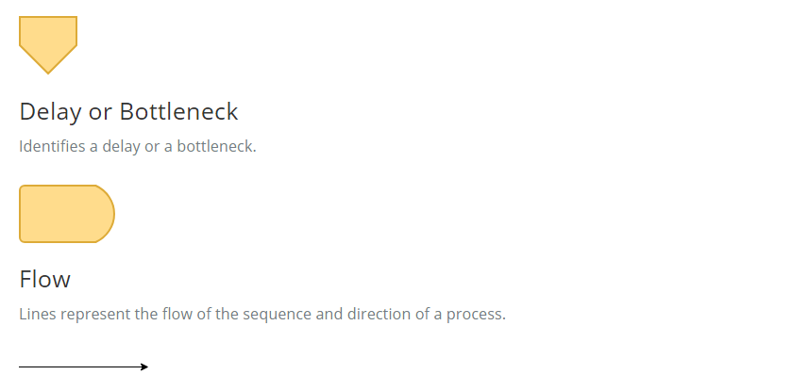

Slide 8
When to Draw Flowchart?
Using a flowchart has a variety of benefits:
It helps to clarify complex processes.
It identifies steps that do not add value to the internal or external customer, including delays; needless storage and transportation; unnecessary work, duplication, and added expense; breakdowns in communication.
It helps team members gain a shared understanding of the process and use this knowledge to collect data, identify problems, focus discussions, and identify resources.
It serves as a basis for designing new processes.
Notes:
Menggunakan diagram alur memiliki beragam manfaat:
Ini membantu untuk memperjelas proses yang kompleks.
Ini mengidentifikasi langkah-langkah yang tidak menambah nilai bagi pelanggan internal atau eksternal, termasuk penundaan; penyimpanan dan transportasi yang tidak perlu; pekerjaan yang tidak perlu, duplikasi, dan biaya tambahan; gangguan dalam komunikasi.
Ini membantu anggota tim mendapatkan pemahaman bersama tentang proses dan menggunakan pengetahuan ini untuk mengumpulkan data, mengidentifikasi masalah, memfokuskan diskusi, dan mengidentifikasi sumber daya.
Ini berfungsi sebagai dasar untuk merancang proses baru.

Slide 9
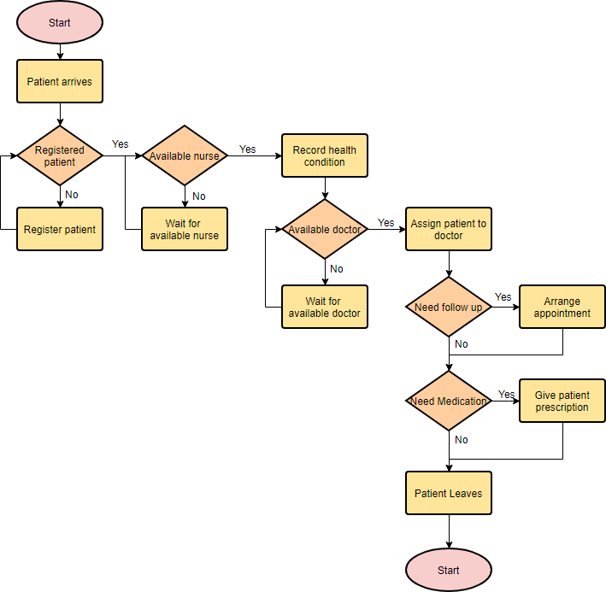
Flowchart Example – Medical Service

Slide 10
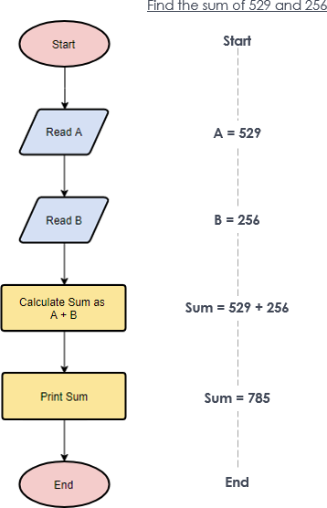
Flowchart Example – Simple Algorithms A flowchart can also be used in visualizing algorithms, regardless of its complexity. Here is an example that shows how flowchart can be used in showing a simple summation process.

Slide 11
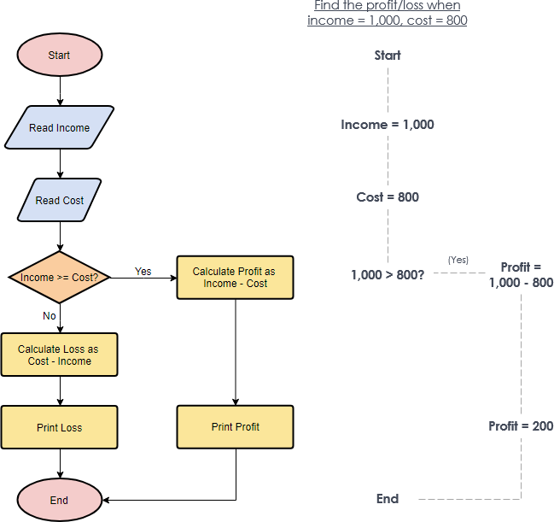
Flowchart Example – Calculate Profit and Loss The flowchart example below shows how profit and loss can be calculated.

Slide 12
TASK 1
Auditor Forum has launched a promotion for its credit card customers. According to the promotion, the customers will receive a gift voucher worth $500 with their monthly bill if they spend $15,000 more than their last month spending and their last month bill is not less than $10,000.

Slide 13
TASK 2
The ATM machines of Auditor Forum Bank contain biometric security features besides conventional PIN control. The customers of Auditor Forum Bank have a choice either to use Card + PIN or Card + Biometric option. Customers of other banks can also withdraw cash from AFB’s ATM; however, they can only use Card + PIN option. A customer’s card is captured by the machine after three consecutive unsuccessful attempts.

Slide 14
TASK 3
Auditor Forum allows its customers to access their blood test reports through Internet. At the time of payment the system creates a unique user ID and password which is printed on the payment receipt. The customer is allowed to log on to Auditor Forum’s website on or after the specified date, to access the report. After logging on to the website the customer is required to input his email address after which the system automatically sends the test report to that email address.
After sending the email, the system automatically signs off the customer and displays the message: “Your report has been sent to your email address.”
If the customer tries to log on before the report receiving date, the system displays the message:
“Your report would be available on the date specified on your payment receipt.”

Slide 15
Assignment collected at :
https://drive.google.com/drive/folders/1VcOpxKb-GjmGo8_5sMA3cGFBEYWhBaU-?usp=sharing
Maximum:
Friday, November, 1st 2019 – 23.00 PM
File .pdf
Format : name_nim_taskWeek10

